Slide 1
Lecture 2: Software Design Methods

Slide 2
Recap – Lecture 1
Design (Verb): Process of Design
Design (Noun): Result of the Design Process, a blue print for the system to be developed
Design Process in non-analytical
Software Design Phase takes the ‘what’ part and produces the ‘how’ part; takes system from ‘problem’ domain to ‘solution’ domain
Software Design is perhaps the most critical factor affecting the quality of the system; it has a major impact on later phases particularly maintenance

Slide 3
Software Design Methods
Design methods provide guidelines on the choices to be made during the design process
Structured Methods, Formal Methods and Object-Oriented Methods

Slide 4
What Support do Design Methods Provide?
Knowledge transfer mechanism
Common standards, guidelines, techniques, criteria and goals to be used by the entire design team
Recording decisions and reasons in a systematic manner
Make sure all factors involved in a problem are considered (all design elements can be traced to some requirements)
Identify important progress milestones

Slide 5
Why Methods Don’t Work Miracles?
Design methods provide guidance and advice
By focusing on a particular domain of problems e.g., data-processing, real time systems, it is possible to provide tighter guidance.
Cooking recipe analogy – designing a software is like writing a cooking recipe
Most methods are applied to different domains to optimize their use that results from familiarity with method

Slide 6
Software Life-cycle
1. Requirements phase
2. Specification phase
3. Design phase
4. Implementation phase
5. Integration phase (in parallel with 4)
6. Maintenance phase
7. Retirement

Slide 7
Software Development Process
If institutionalized can constrain creativity rather than support it
Many forms and variations of development process
Presence of feedback loops between the various stages of software process

Slide 8
Linear Development Process
Mainly based on the waterfall model
Provides a strong management framework for planning, monitoring and controlling
Transform model and its limitations (Formal approaches)

Slide 9
Incremental Development Process (non linear process)
Limitations of linear development process
Prototypes – constructed to explore an idea more completely before the actual construction starts
  Evolutionary
  Experimental
  Exploratory
Reactive development

Slide 10
Context for Design
Ref: (Fig 3.1 Chapter 3 Budgen 2003)
Regardless of how the software development tasks are organized, design is strongly linked to the tasks that precede it – Requirements Specification and Analysis

Slide 11
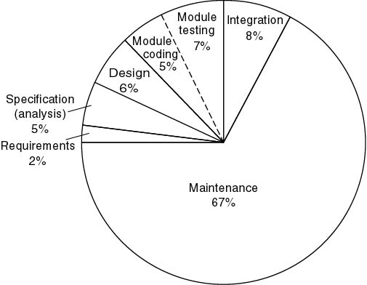
Approximate Relative Cost of Each Phase
1976–1981 data
Maintenance constitutes 67% of total cost

Slide 12
Good and Bad Software
Good software is maintained—bad software is discarded
Different types of maintenance
  Corrective maintenance [about 20%]
  Enhancement
    Perfective maintenance [about 60%]
    Adaptive maintenance [about 20%]

Slide 13
Specification and Maintenance Faults
60 to 70 percent of faults are specification and design faults
Data of Kelly, Sherif, and Hops [1992]
  1.9 faults per page of specification
  0.9 faults per page of design
  0.3 faults per page of code

Slide 14
Specification and Maintenance Faults (contd)
Data of Bhandari et al. [1994] - Faults at end of the design phase of the new version of the product
  13% of faults from previous version of product
  16% of faults in new specifications
  71% of faults in new design

Slide 15
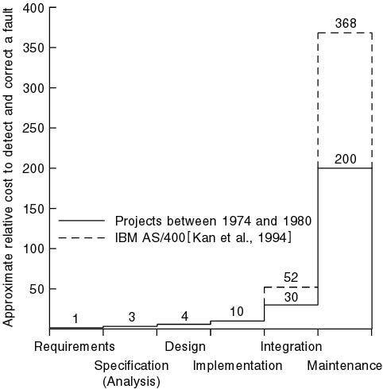
Cost to Detect and Correct a Fault

Slide 16
Structured Paradigm
The structured paradigm had great successes initially
  It started to fail with larger products (> 50,000 LOC)
Maintenance problems (today, up to 80% of effort)
Reason: structured methods are
  Action oriented (finite state machines, data flow diagrams); or
  Data oriented (entity-relationship diagrams, Jackson’s method);
  But not both

Slide 17
The Object-Oriented Paradigm (contd)
Both data and actions are of equal importance
Object:
  Software component that incorporates both data and the actions that are performed on that data
Example:
  Bank account
    Data: account balance
    Actions: deposit, withdraw, determine balance

Slide 18
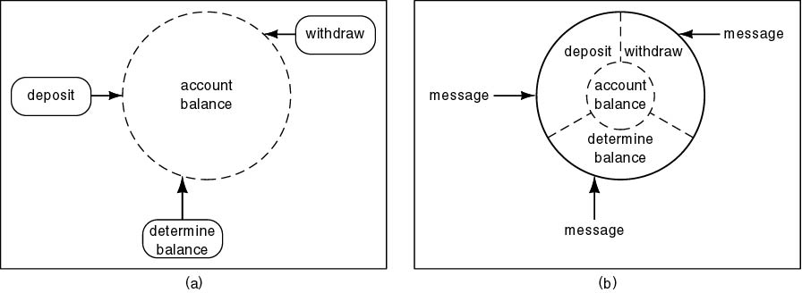
Structured versus Object-Oriented Paradigm
Information hiding
Responsibility-driven design
Impact on maintenance, development

Slide 19
Key Aspects of Object-Oriented Solution
Conceptual independence
  Encapsulation
Physical independence
  Information hiding
Impact on development
  Physical counterpart
Impact on maintenance
  Independence effects

Slide 20
Responsibility-Driven Design
Also called “Design by Contract”
Send flowers to your aunt in Iowa City
  Call 1-800-FLOWERS
  Where is 1-800-FLOWERS?
  Which Iowa City florist does the delivery?
  Information hiding
Object-oriented paradigm
  “Send a message to a method [action] of an object“

Slide 21
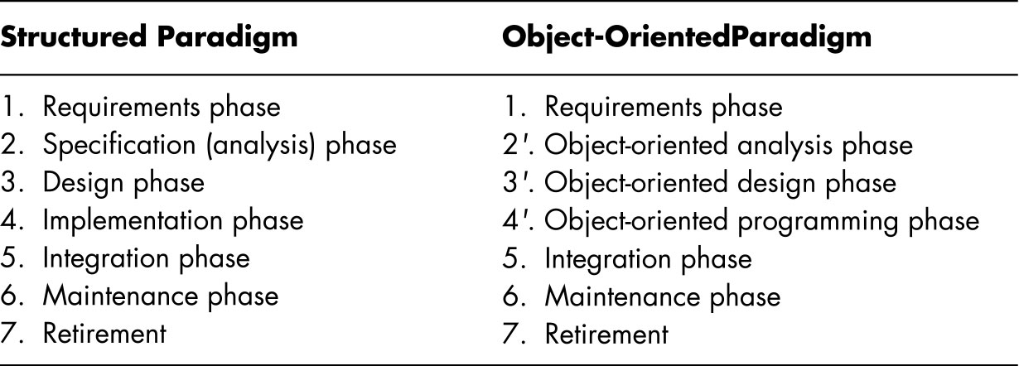
Transition From Analysis to Design
Structured paradigm:
  Sharp transition between analysis (what) and design (how)
Object-oriented paradigm:
  Objects enter from very beginning

Slide 22
Analysis/Design “Hump”
Systems analysis
  Determine what has to be done
Design
  Determine how to do it
  Architectural design—determine modules
  Detailed design—design each module

Slide 23
Removing the “Hump”
Object-oriented analysis
  Determine what has to be done
  Determine the objects
Object-oriented design
  Determine how to do it
  Design the objects

Slide 24
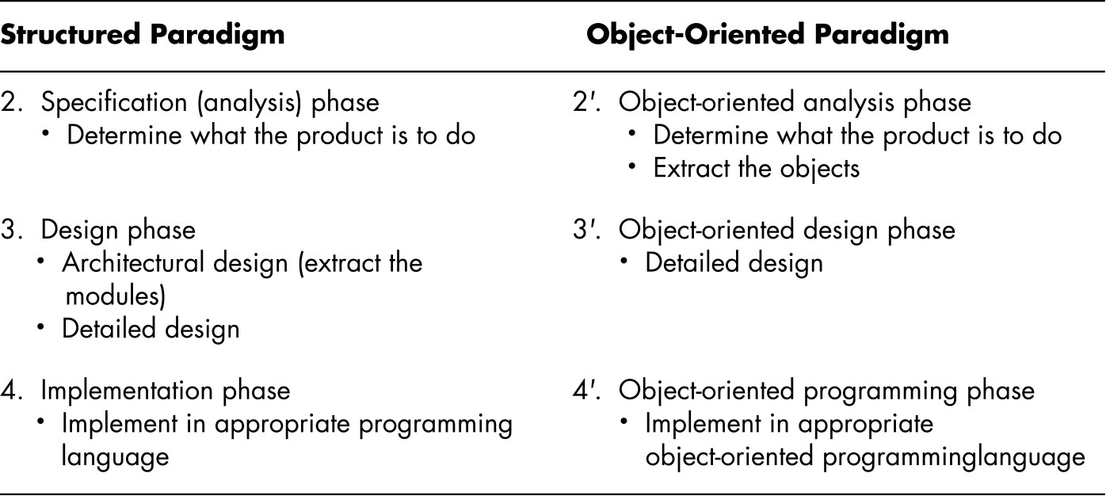
In More Detail
Objects enter here

Slide 25
Warning
Do not use the object-paradigm to enhance a product developed using the structured paradigm
  Water and oil do not mix
Exception: if the new part is totally disjoint
  Example: adding a GUI (graphical user interface)

